Slide 1



Introduction to Artificial Intelligence
Author: Sumaiya Jannat
Created with Pi

Slide 2
CONTENTS
1. What is AI?
2. Agents and Environments
3. Problem-Solving Agents
4. Uninformed Search Strategies
5. Informed Search Strategies
6. AI Game Examples
7. Defining Constraint Satisfaction Problems
8. Constraint Propagation: Inference in CSPs
Notes:
make all box horizontallly

Slide 3

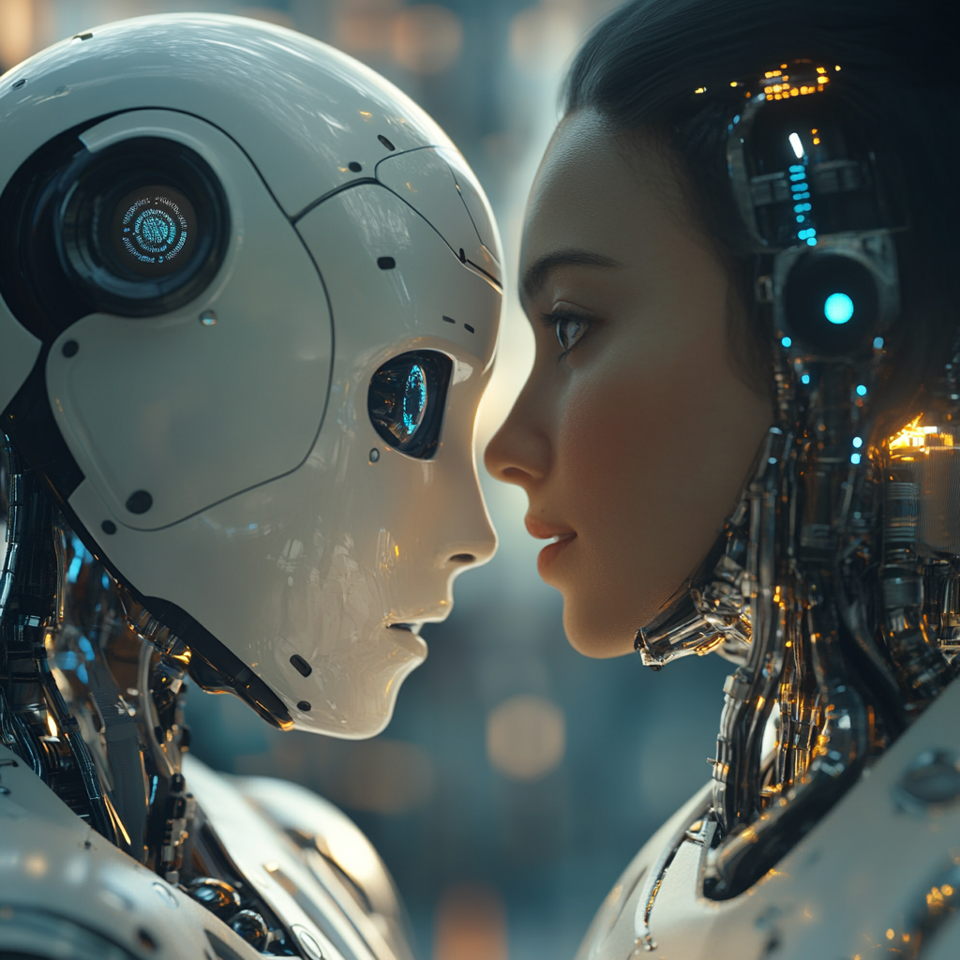
What is AI?
Artificial Intelligence (AI) is the simulation of human intelligence in machines that can think, learn, and make decisions.

Slide 4
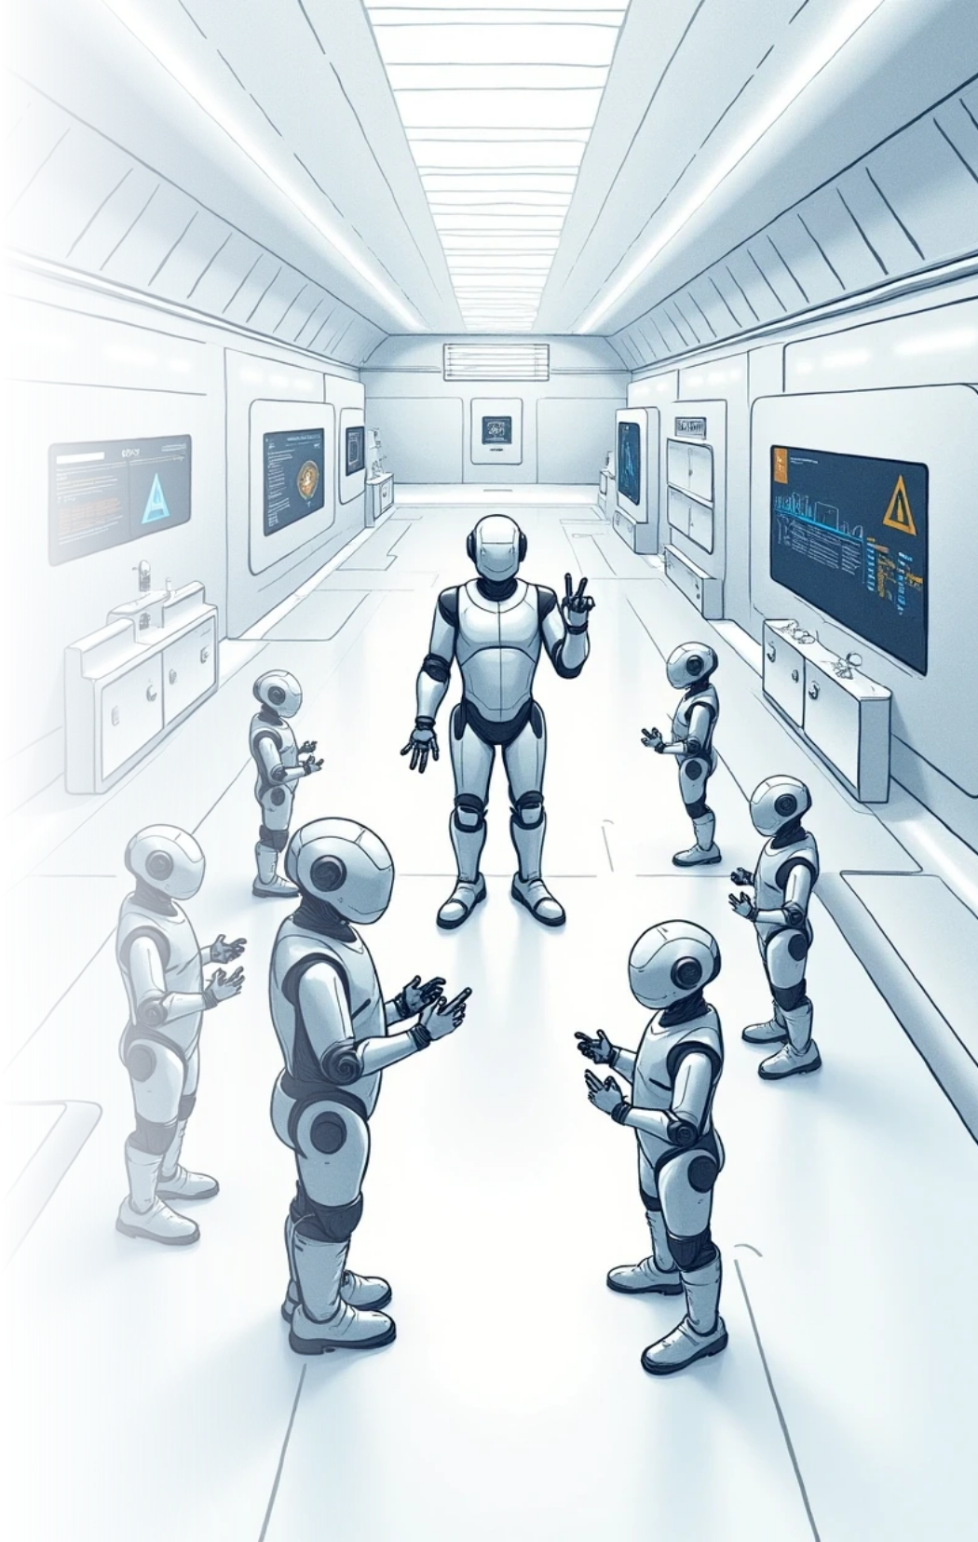





2. Agents and Environments
Simple reflex agents
Model-based reflex agents
Goal-based agents
Utility-based agents
Learning agents

Slide 5







3. Problem-Solving Agents
1
2
3
Vacuum world
8-puzzle
8-queens problem

Slide 6




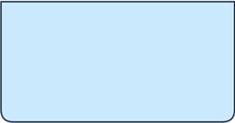



5. Uninformed Search Strategies
1
2
3
Breadth-first search
Depth-first search
Bidirectional search
4
5
Depth-limited search
Iterative deepening depth-first search

Slide 7
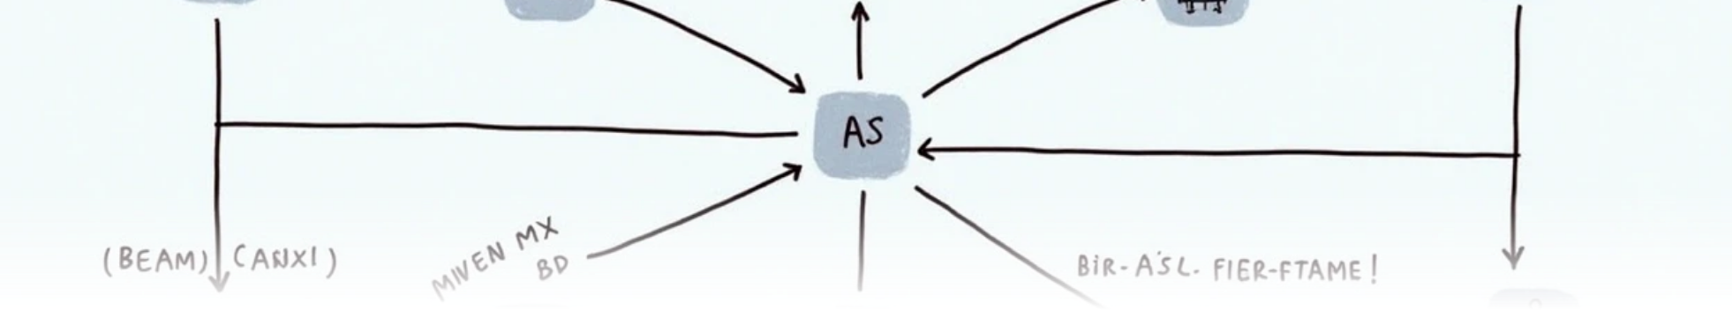



6. Informed Search Strategies
Best First Search
Hill-climbing search
Beam Search
A*
Min Max Algorithm
Alpha-Beta Pruning

Slide 8





7. AI Game Examples
1
Tic-Tac-Toe
2
Chess
3
Snake game

Slide 9
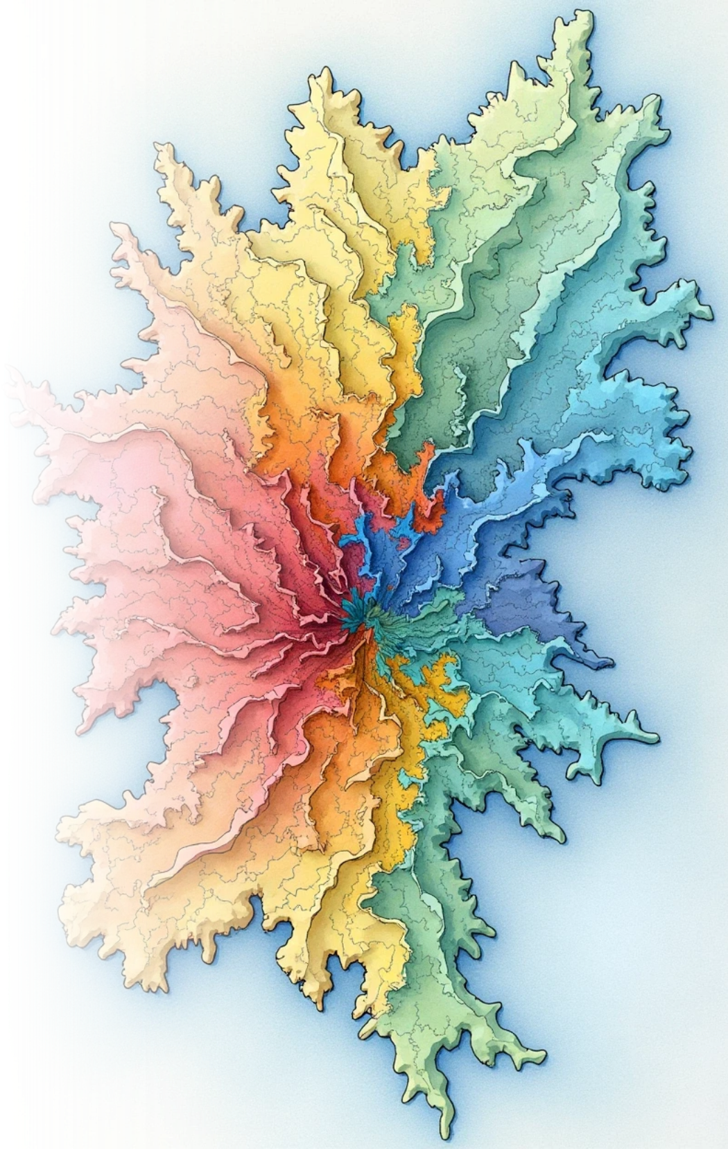


8. Defining Constraint Satisfaction Problems
Map Coloring
Map coloring
Variations on the CSP formalism

Slide 10
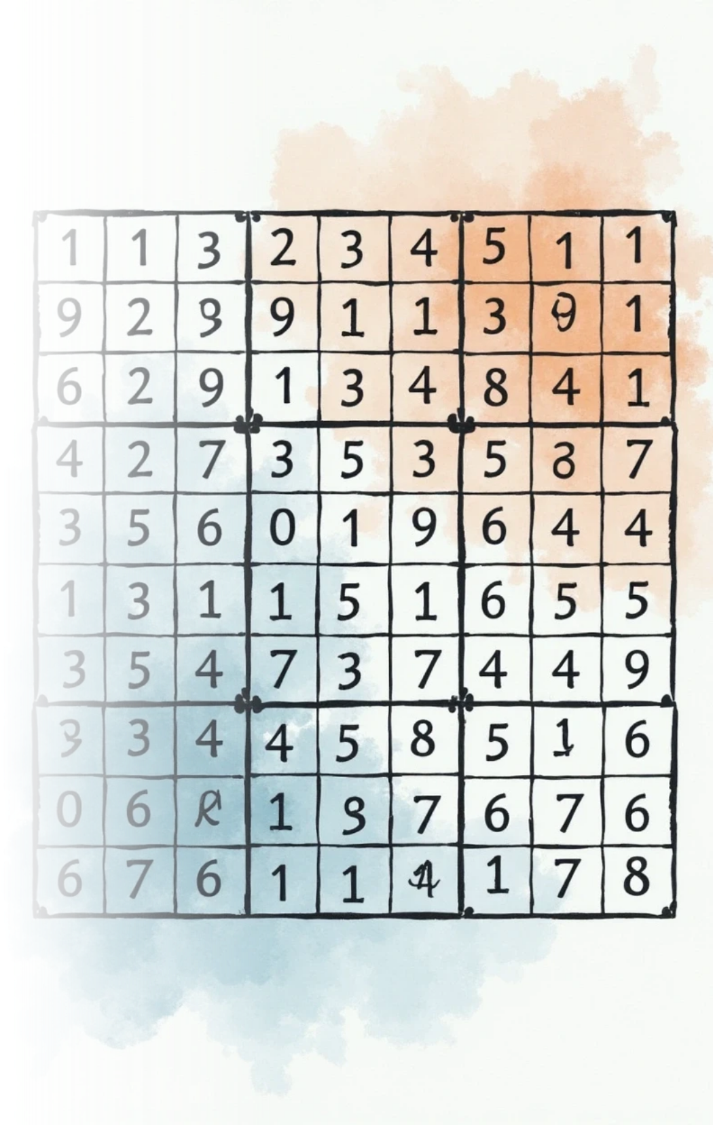





9. Constraint Propagation: Inference in CSPs
1
Node consistency
2
Arc consistency
3
Path consistency
4
Global constraints

Slide 11

Thank You

